Slide 1

Bayesian Logistic MCMC Regression Model
Jing Liu
MPH, CPH-Provisional, Department of Epidemiology and Biostatistics, College of Public Health, University of South Florida, Tampa, FL, USA.
Notes:
Out project is about air pollution in California

Slide 2
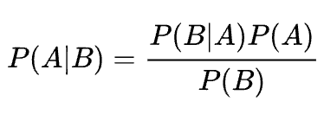
Bayesian
Likelihood/conditional probability
Prior
Bayes’ Theorem:
Evidence/marginal probability
Posterior = (Likelihood * Prior) / Evidence
Notes:
1.What is Bayesian:
A method that can update our understanding of the probability of a parameter as we gather more data and evidence
2.What can Bayesian do:
Inference and Prediction:
Prediction:
As we all know that regression models can do prediction too.
So what’s differences between other regression prediction and Bayesian prediction?
Regression,
In linear regression, we use the ordinary least squares method to fit a line and make predictions based on that line.
In logistic regression, it uses maximum likelihood estimate, so it will give us the maximum probability the we can see the outcome,
but in both linear and logistic regression, the estimate will be a point estimate.
But Bayesian will predict based on prior, likelihood, and previous results will be used to do the next prediction. and the prediction will be the posterior distribution
Example of Prediction: Bayesian methods can be used for prediction. For example, to predict the likelihood of rain, we can use prior information such as cloud cover, humidity, temperature, and wind conditions. As we gather more data, our predictions become more accurate because the Bayesian method updates the probability based on new evidence.
What prediction can Bayesian do? Example of raining, prior: clouds, humidity, temperature, winds…, we get the probability of raining, which is the posterior
The other function:
Inference: In this workshop, we will focus more on inference using Bayesian methods.
Here, the posterior here is also very important because this is pretty much like estimates of the regular regressions
So if you want to know whether this prior or variable is important or significant, you will need to analyze the Bayesian estimate, or (posterior distribution),
Please note that, a distinctive difference here is that the estimate from regression like logistic is fixed, but Bayesian’s inference is a posterior distribution.
it is actually a probability density function or PDF
Posterior Distributions or PDF: Instead of providing a single point estimate, Bayesian methods give a distribution for each parameter, reflecting the uncertainty about the parameter values.
Please remember this word, and we will talk about this later
But here, we will focus more on inference using Bayesian

Slide 3
Bayes’ Theorem Activity
Prior probability: probability of rain: 0.15
Conditional probability/likelihood: P(carry an umbrella | rain) = 0.3
Marginal probability?
Hypothesis / prior | probability
rain | 0.15
No rain | 0.85
Hypothesis / likelihood | Umbrella (conditional probability) | No numbrella (conditional probability)
Rain | 0.3 | 0.7 | 1
No rain | 0.05 | 0.95 | 1
https://learningstatisticswithr.com/book/bayes.html#likelihoods-theories-about-the-data
Notes:
But first, we start the class with a math exercise to warmup your brain!
We are going to talk about probability here, so what is a probability?
So what is a probability?
A chance?, a risk or likelihood, in common language
By definition: A measure of the likelihood that a specific event will occur.
Ranges from 0 to 1
Now let’s start the activity:
This a prediction activity about probability of rain
Sure the posterior here is the probability of raining if I carry an umbrella today, prior is the probability of rain; likelihood: um|rain
So this is to say that, if you see me carrying umbrella today, how likely it will rain?
Now let start:
The table…
Prior probability is a belief, or knowledge that we know about the event, rain, 0.15
Conditional probability: a condition, under a condition of rain, the P of me carrying umbrella is 0.3,
under a condition of no rain, the P of me carrying umbrella is 0.05
So now, we already got the prior and conditional probability, what about marginal probability?

Slide 4
Bayes’ Theorem Activity (cont.)
1st step: calculate joint probability:What is a joint P?
P(Rain and umbrella) = P(rain)*P(umbrella|rain)= 0.15*0.3=0.045
Hypothesis / prior | probability
rain | 0.15
No rain | 0.85
likelihood | Umbrella | No numbrella
Rain | 0.3 | 0.7
No rain | 0.05 | 0.95
 | Umbrella | No umbrella | Total
Rain | 0.15*0.3=0.045 | 0.15*0.7=0.105 | 0.15
No rain | 0.05*0.85=0.0425 | 0.85*0.95=0.8075 | 0.85
Total | ??? | ??? | 1
Notes:
To get marginal probability, we need joint P
What is a joint P?
P(Rain and umbrella) = P(rain)*P(umbrella|rain)= 0.15*0.3=0.045
…
Next step, we will calculate the marginal P…

Slide 5


Bayes’ Theorem Activity (cont.)
2nd step: calculate marginal probability: P(umbrella) = P(umbrella, rain) + P(umbrella, no rain) = 0.045+0.0425 = 0.875
 | Umbrella | No umbrella | Total
Rain | 0.045 | 0.105 | 0.15
No rain | 0.0425 | 0.8075 | 0.85
Total | 0.0875 | 0.9125 | 1
 | Umbrella | No umbrella | Total
Rain | P(Umbrella, Rain) | P(No umbrella, Rain) | P(Rain)
No rain | P(Umbrella, No rain) | P(No umbrella, No rain) | P(No rain)
Total | P(Umbrella) | P(No umbrella)
Notes:
Colored in red: joint probability
Colored in blue: marginal probability
In the table:
Marginal P is the total of the joint P, and marginal Ps sum up to 1.
Can use this to check you calculation

Slide 6
Bayes’ Theorem Activity (cont.)
P(rain) = 0.15
Conditional probability: carrying an umbrella given rain: P(umbrella | rain): 0.3
Marginal probability: P(umbrella) = 0.0875
Posterior probability: P(rain|umbrella) = P(umbrella|rain)*P(rain)/P(umbrella)= 0.3*0.15/0.0875 = 0.514
 | Umbrella | No umbrella | Total
Rain | 0.045 | 0.105 | 0.15
No rain | 0.0425 | 0.8075 | 0.85
Total | 0.0875 | 0.9125 | 1
Notes:
Finally, we can calculate the posterior probability.
Let's do the math now.
Probablity of rain: recall the previous slides: 0.15
Conditional P or likelihood: recall from previous: 0.3, (umbrella given rain)

Slide 7
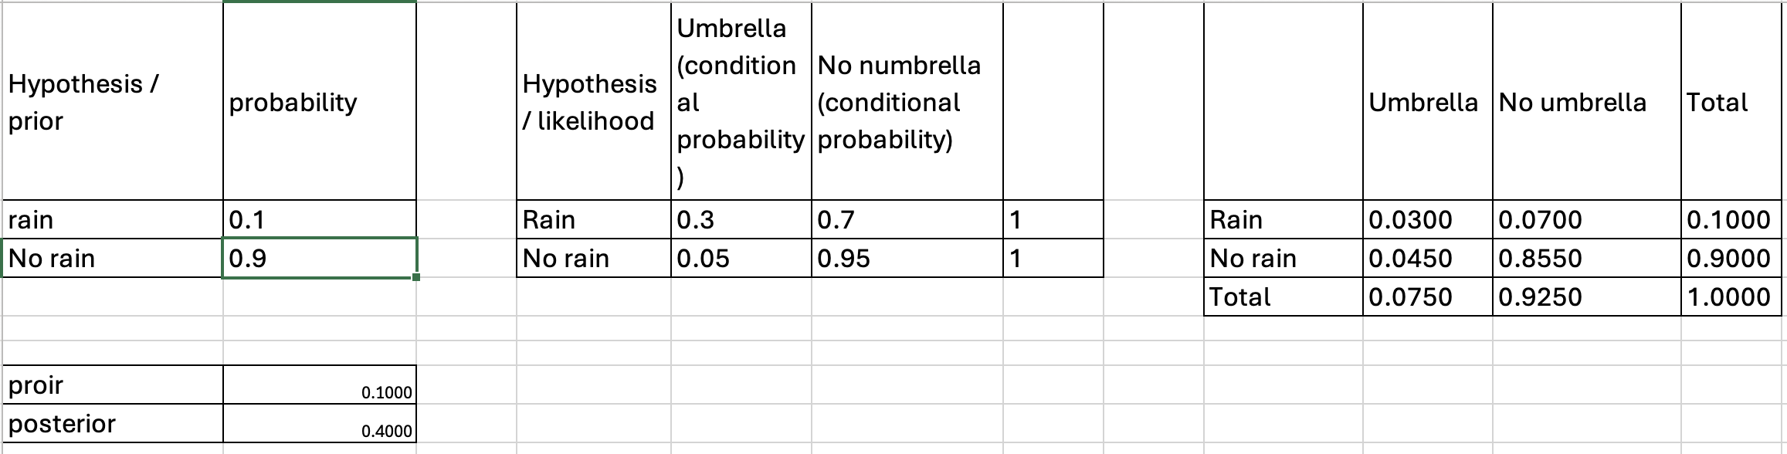
See class material: book of bayes.xlsx
Notes:
In this table, you can modify the prior and likelihood, and get different posterior
This is a point estimate

Slide 8
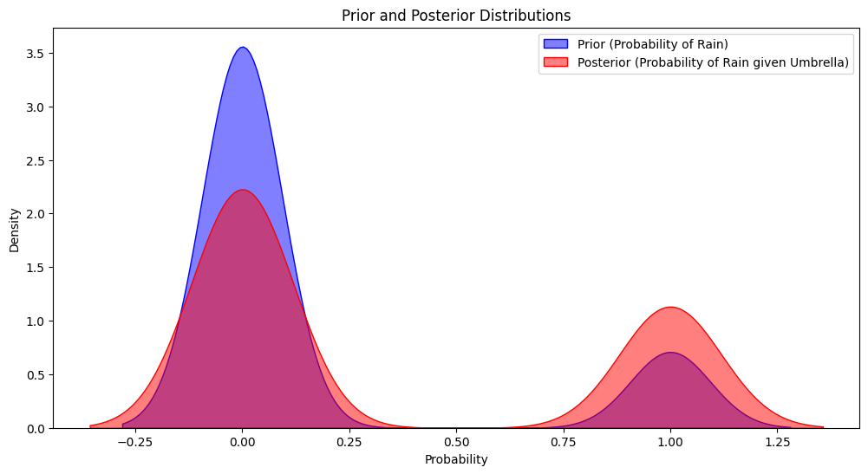
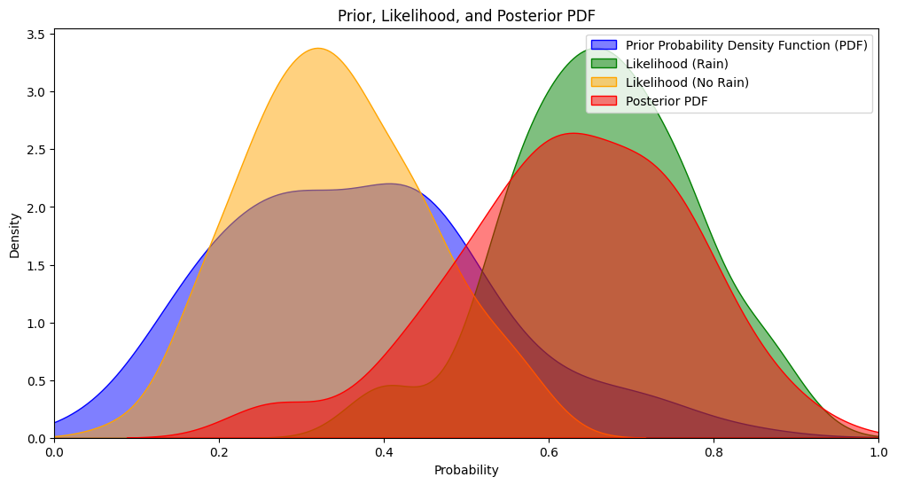
Prior, likelihood and posterior distributions or Probability Density Function (PDF)
A PDF describes the probability density of a continuous random variable.
Higher value: more likely to see a certain value
Area under curve should be 1
See material: Bayes.ipynb
Notes:
Now we will check the PDF in python

Slide 9
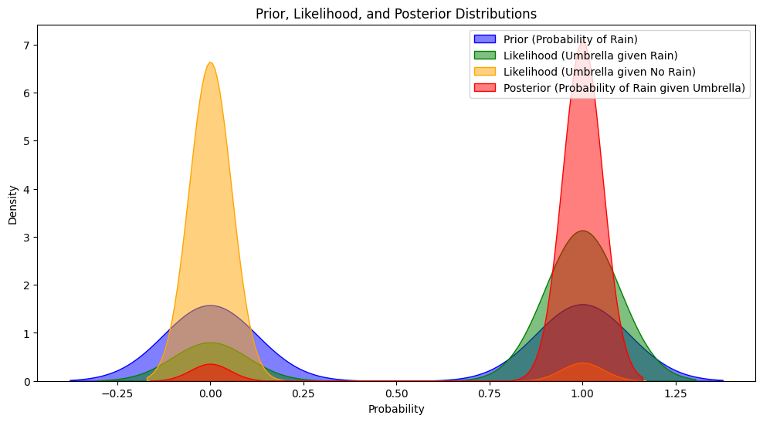
Code in python, see Bayes.ipynb
prior_rain = 0.5
likelihood_umbrella_given_rain = 0.8
likelihood_umbrella_given_no_rain = 0.05
Notes:
If I adjust the probabilities, the peaks will change accordingly/
There are 2 peaks because rain/no rain, umbrella/no umbrella are binary varibales.

Slide 10
Modules for Python activity
To install Jupyter notebook: https://jupyter.org/install
Modules for visualize PDF:
import numpy as np
import matplotlib.pyplot as plt
import seaborn as sns
Try to run the code in Bayes.ipynb

Slide 11
Takeaways for Bayes’ Theorem:
Posterior = (Likelihood * Prior) / Evidence
P(rain) or prior: the knowledge from previous experiences. Not influenced by our data
P(B|A) or Likelihood: conditional probability, which represents how probable the new evidence is, given the initial hypothesis.
P(B) or evidence: the marginal probability: the total probability of event B.
Plot the PDF can get the distribution of prior, posterior and likelihood rather than the point estimation (e.g. such as means or medians), which is meaningful in future practical use (e.g. understanding uncertainty and making decisions based on probabilistic reasoning).

Slide 12
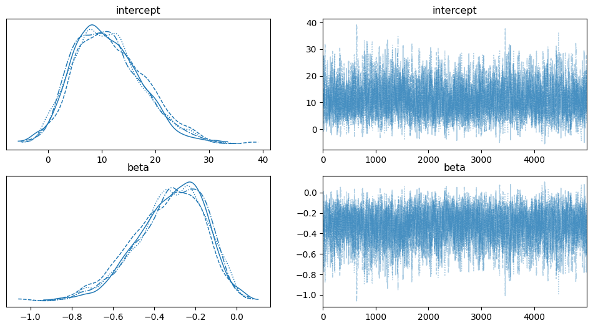
Bayesian Logistic MCMC with Python:
Bayesian is a non-frequentist method
Estimates not based on population/sample mean or SD
The results do not contain p-value, CI…
Usually employed with sampling process, MCMC
Notes:
Think about the knowledge we just learned:
What Bayesian MCMC should be:
Here, I Summarize key points of Bayesian:
non-frequentist, will explain this later; As we talked earlier, Bayesian’s inference is PDF rather than a point estimate, so Bayesian is a non-frequentist method
Estimate not based on population or sample directly; recall PDF
No p-value or CI
Sampling process, MCMC. This part maybe a little bit hard. MCMC is pretty much like the “evidence” by iterating over the posterior distribution. This iterative process serves as the “evidence” for Bayesian inference, allowing us to make probabilistic statements about parameters. But in the background, python does not calculate “evidence” or marginal P. instead it will calculate the PDF of the posterior, so we can know the Bayesian inference from the result.
MCMC vs. bootstrap:
Bootstrap is commonly used in the frequentist method, to resample from the population

Slide 13
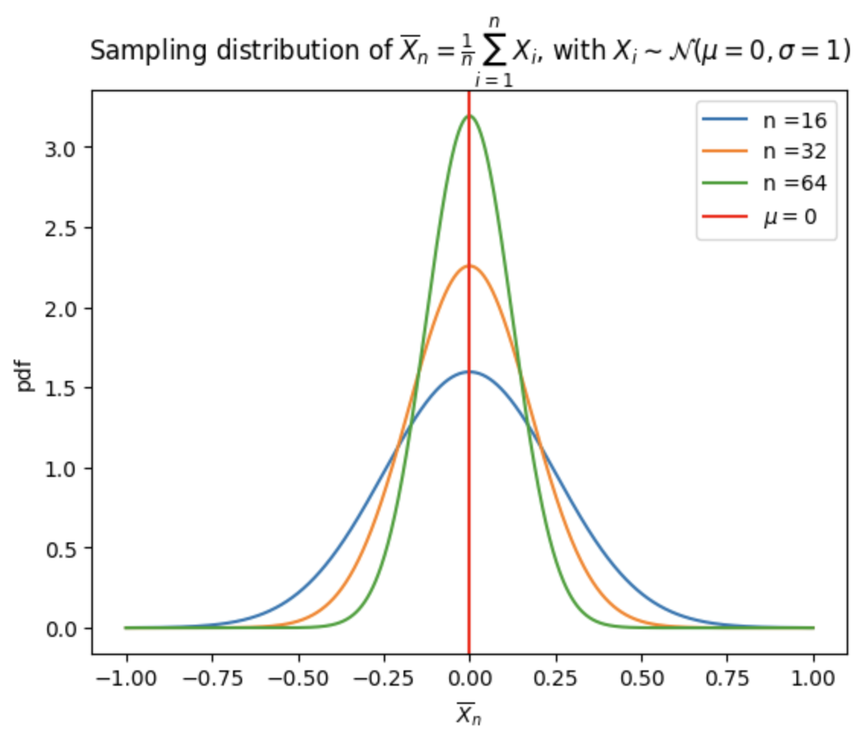
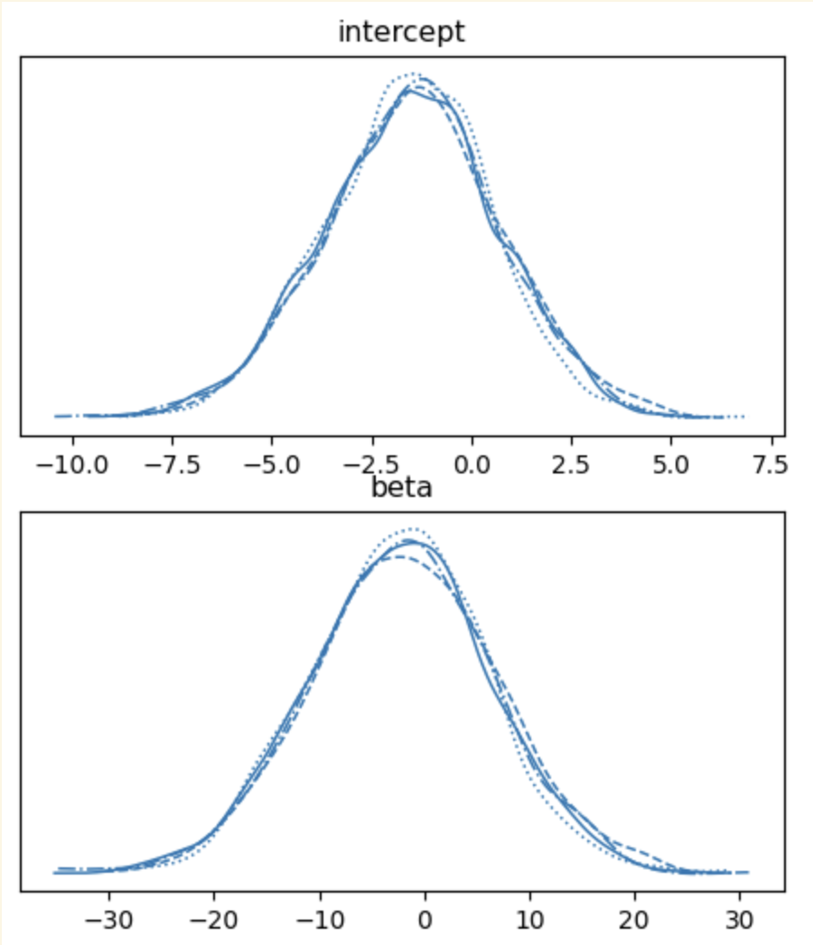
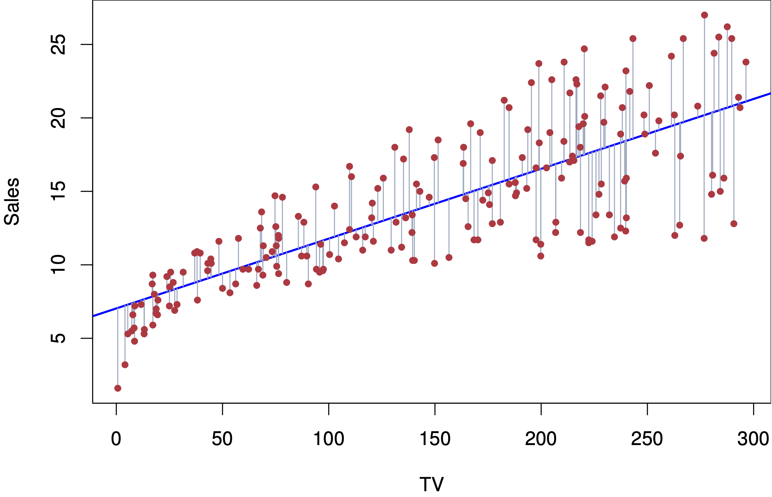
Comparison between frequentist and non-frequentist
Frequentist:
Sampling distribution: mean, variance, SD …
Parameters are fixed: y=𝜶+𝜷*x, 𝜶 and 𝜷 are fixed.
Hypothesis testing: H₀ and H₁
Non-Frequentist:
Use prior distributions and likelihood
Parameters are not fixed variables, they are PDFs
Inferences are made using posterior distributions
Simple linear regression — STATS 202. (n.d.). https://web.stanford.edu/class/stats202/notes/Linear-regression/Simple-linear-regression.html
Notes:
Let’s talk more about frequentist and non-freq
…
In freq, estimates or parameters like beta is fixed, coz this is point estimate
…
Non-freq: estimates are not fixed, but PDF, so inference would be a kind of distribution.
You may ask: if parameters are random, how can I get inferences and how do I do analysis?
Here I will talk more on MCMC sampling process.
Because MCMC can sample from the posterior distribution many times.
4 lines and they are trying to converge together and show us the posterior distribution. This is because I set the chain = 4 here. See code
More on Bayesian MCMC:
Like other regression models, Bayesian has another function, we can get Bayesian inference like the ordinary regression inference
This is to say that, we can get an estimate or beta, like in other regression, but we may need a helper, MCMC to do this for us.
This is because, Bayesian can calculate posterior distribution, and MCMC can sample from the posterior distribution, and calculate the estimate,
Additionally, Bayesian MCMC can work better than the other regression, ex logistic regression, because:
Bayesian MCMC can give me estimation based on MCMC sampling results
so the MCMC will do many estimations and calculate the mean estimates or betas and HDI,
But by logistic it self will only fit in the data into regression and calculate beta only once

Slide 14
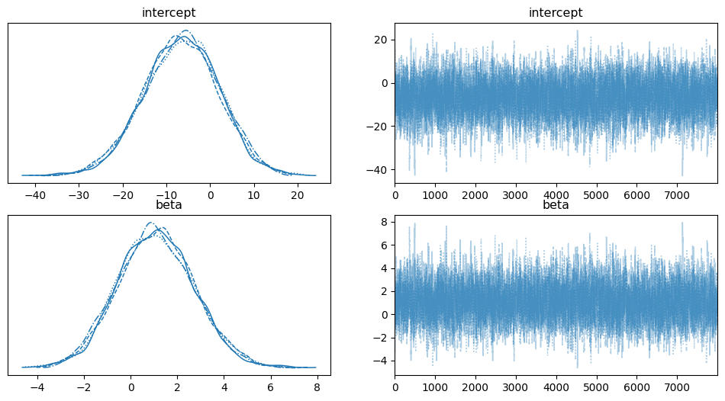
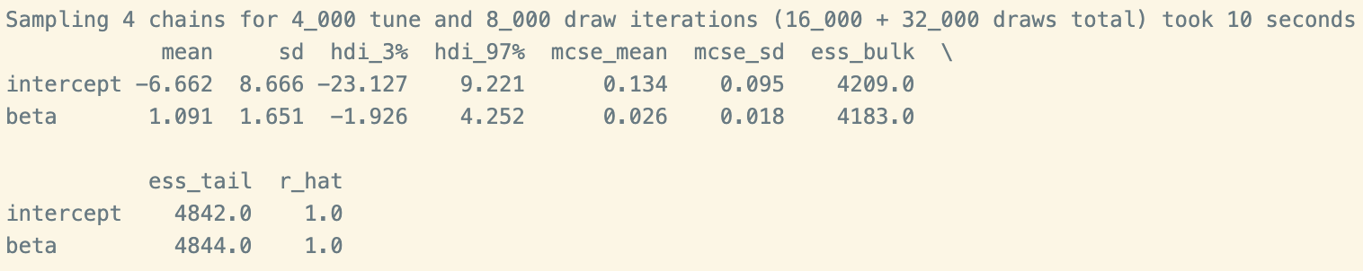
Bayesian Logistic MCMC in Python (Cont.)
MCMC: sample from a probability distribution; calculate the estimates and quantify parameter uncertainty
3% and 97% HDI: Highest Density Interval
94% probability that the true parameter value lies within this range
In Python, Hamiltonian Monte Carlo (HMC) is used for a more efficient sampling
Notes:
Lets talk about MCMC sampling.
Sample from a probability distribution, and this process can give us estimation, which is mean estimate, and high-density interval. Here mean is not average, \\
Bayesian Mean: The average of this distribution, weighted by the probability of each effect size.
The mean of these combined samples represents the Bayesian mean, which is the weighted average of the posterior distribution.
in frequentist methods: we have CI, which can tell us whether the estimations is significant or not. If the CI is wide, the error of the estimation is large. So generally, CI can tell us how confident we are about the estimation. This is because people love to know how confident I am to say my estimation is correct,
MCMC provide HDI, which is pretty much like the confidence interval, and if HDI includes 0, the estimation is non-significant.
Usually, the python will provide 3% and 97% interval, so we can say we are 94% confident that the true estimate fall within this range.
Using MCMC sampling with Bayesian, we can plot the distribution and MCMC tracing process
The value in the trace plots is vibrating around the beta value: -0.325
Another thing about MCMC sampling:
Traditional MCMC sampling was like random walking, and this may result in a high level of autocorrelation.
The process would be like: MCMC will choose random samples but the steps would be tentative and without guide, so the steps would be very small. And therefore, the results would be very closely correlated with each other. We call this kind of correlation, an autocorrelation.
In this way, we will need a larger sampling size to get accurate estimate
But, Hamiltonian method, (HMC) can use a guided sampling strategy and adjust the sampling steps. And it can do sampling based on certain evidence or tendencies. So it can do sampling with larger steps, thus reducing the autocorrelation.
As you can see from the plots that: even the distribution of estimations are skewed, MCMC and bayesian can still do estimation
This means that this Bayesian MCMC is very robust.

Slide 15
Bayesian Logistic MCMC in Python (Cont.)
Adjust parameters in MCMC:
Draws: iteration
Tune: warmup
Chain: MCMC chains (Gelman et al., 2013)
Target accept: desired acceptance rate, by NUTS algorithm (Hoffman & Gelman, 2014)
Max tree-depth: NUTS algorithm (Hoffman & Gelman, 2014)
* NUTS is an extension of HMC
* NUTS can adjust the path automatically
Notes:
Iteration: Total number of samples to draw from the posterior distribution. A large iteration can increase the accuracy of estimation
Warmup: all living arrangement categories should be consolidated into a few options for presentation/manuscript
Chain: Number of independent MCMC chains to run. Generally we start with 4 chains to get an ideal equilibrium of MCMC process
The next 2 are based on NUTS algorithm. NUTS is based on HMC, but this algorithm has some advantages over the HMC.
You have to tune papameters in HMC manually. But NUTS can tune them automatically.
Target accept: Typical values range from 0.8 to 0.95. Higher acceptance rates can indicate that smaller steps are being taken, potentially increasing computation time.
The Gelman–Rubin convergence diagnostic: rhat The R-hat statistic, also known as the Gelman-Rubin statistic,

Slide 16
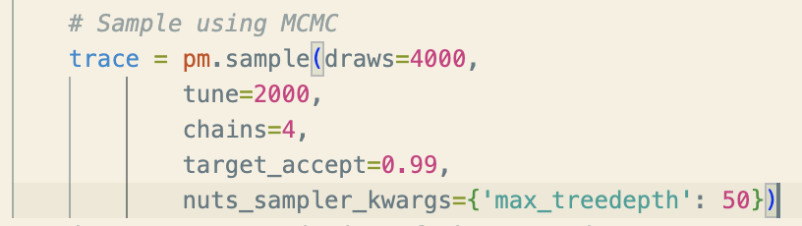
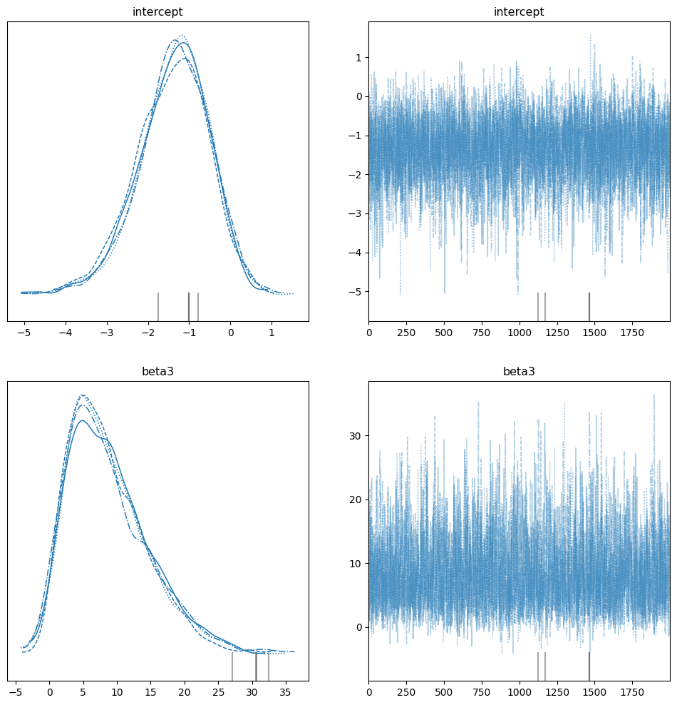
Bayesian Logistic MCMC in Python (Cont.)
Divergences in MCMC tracing
Notes:
However, we can not expect every time MCMC can converge well
Plots showing iterations that did not converge.

Slide 17
Python activity
Import Modules for Bayesian MCMC
import numpy as np
import pandas as pd
import pymc as pm
import arviz as az

Slide 18
Python activity (cont.)
# Load the data from an Excel file
data = pd.read_excel("PATH")
# define your dependent and independent variables
X = data['wind_act']
y=data['hotspt']

Slide 19
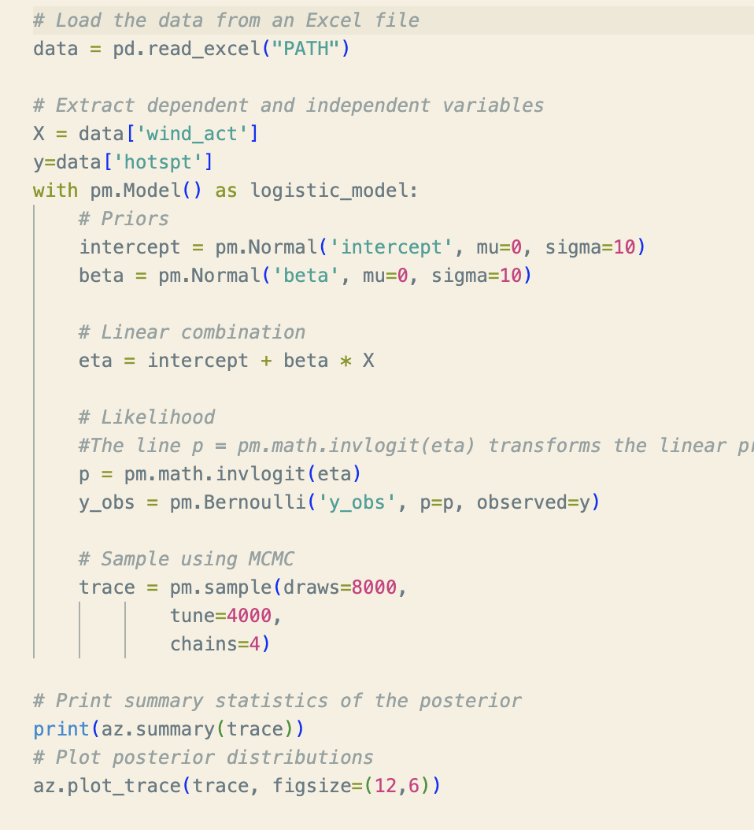
Python activity (cont.)
with pm.Model() as logistic_model:
# Priors
intercept = pm.Normal('intercept', mu=0, sigma=10)
beta = pm.Normal('beta', mu=0, sigma=10) # Linear combination
eta = intercept + beta * X # Likelihood
#The line p = pm.math.invlogit(eta) transforms the linear predictor eta into a probability p using the inverse logit function
p = pm.math.invlogit(eta)
y_obs = pm.Bernoulli('y_obs', p=p, observed=y) # Sample using MCMC
trace = pm.sample(draws=8000,
tune=4000,
chains=4)

Slide 20
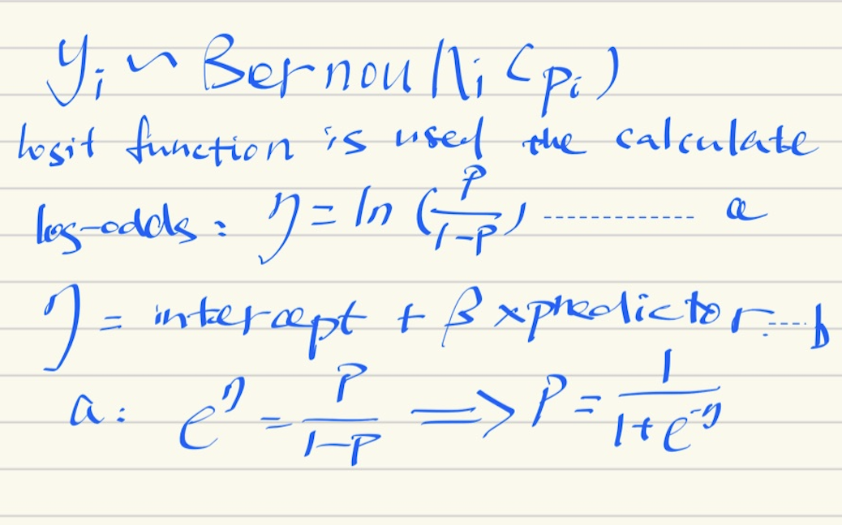
Inverse Logit Function
p = pm.math.invlogit(eta)
Notes:
In the background, python PYMC will do this calculation for you with the code

Slide 21
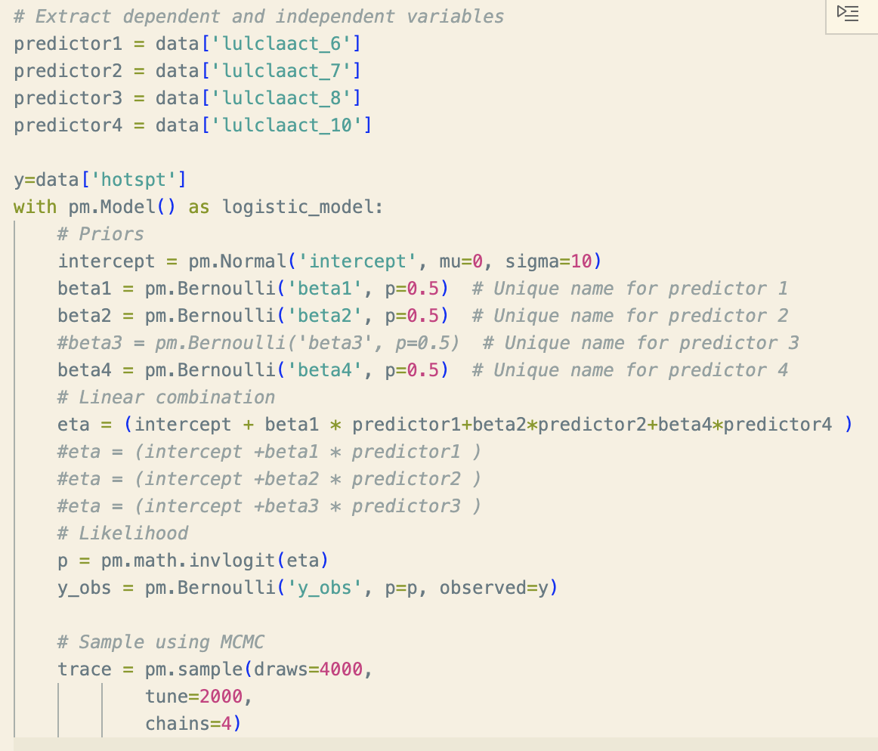
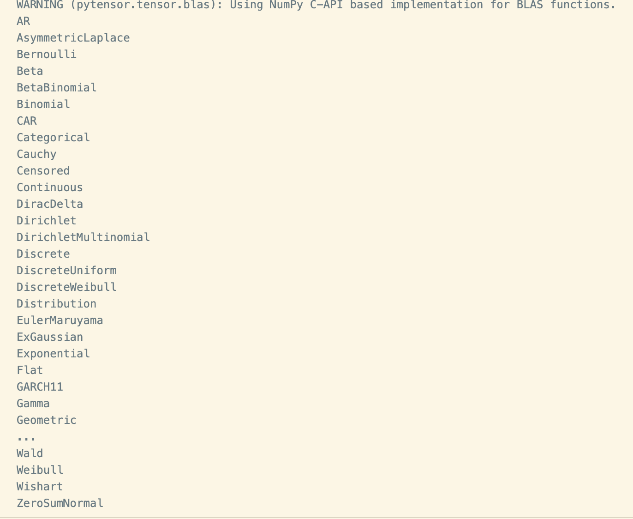
Bayesian with non-normal priors
Prior: your belief
If you believe that your prior has a distribution other than Gaussian, there are many other choices in PYMC:

Slide 22
References
References
Boser, B., Guyon, I., & Vapnik, V. (1992). A training algorithm for optimal margin classifiers. Annual Workshop on Computational Learning Theory: Proceedings of the Fifth Annual Workshop on Computational Learning Theory; 27-29 July 1992, 144–152. https://doi.org/10.1145/130385.130401
Breiman, L. (2001). Random forests. Machine Learning, 45(1), 5–32. https://doi.org/10.1023/A:1010933404324
County of Los Angeles. (n.d.). About LA County. https://lacounty.gov/government/about-la-county/about/
Cover, T. and Hart, P. (1967) Nearest Neighbor Pattern Classification. IEEE Transactions on Information Theory, 13, 21-27. http://dx.doi.org/10.1109/TIT.1967.1053964
Fix, E. and Hodges, J.L. (1951) Discriminatory Analysis, Nonparametric Discrimination: Consistency Properties. Technical Report 4, USAF School of Aviation Medicine, Randolph Field.
Gelman, A., Carlin, J. B., Stern, H. S., Dunson, D. B., Vehtari, A., & Rubin, D. B. (2013). Bayesian data analysis. In Chapman and Hall/CRC eBooks. https://doi.org/10.1201/b16018
Gelman, A., Hill, J., & Vehtari, A. (2020). Regression and Other Stories. Cambridge: Cambridge University Press.
Getis, A., & Ord, J. K. (1992). The Analysis of Spatial Association by Use of Distance Statistics. Geographical Analysis, 24(3), 189–206. https://doi.org/10.1111/j.1538-4632.1992.tb00261.x
Griffith D. A. (2003). Spatial autocorrelation and spatial filtering gaining understanding through theory and scientific visualization first edition 2003. Springer Berlin Heidelberg. https://doi.org/10.1007/978-3-540-24806-4
Gunasegaran, T., & Cheah, Yu.-N. (2017). Evolutionary cross validation. 2017 8th International Conference on Information Technology (ICIT), 89–95. https://doi.org/10.1109/ICITECH.2017.8079960
Hegde, M. (2021, January 1). Giovanni - Time Averaged map. https://giovanni.gsfc.nasa.gov/giovanni/#service=TmAvMp&starttime=2021-01-01T00:00:00Z&endtime=2021-12-31T23:59:59Z&shape=tl_2014_us_state/shp_13&bbox=-126.5625,17.71,-105.4687,41.6162
Hoffman, M. D., & Gelman, A. (2014). The No-U-Turn sampler: adaptively setting path lengths in Hamiltonian Monte Carlo. J. Mach. Learn. Res., 15(1), 1593-1623.
Jacob, B. G., Izureta, R., Bell, J., Parikh, J., Loum, D., Casonova, J., Gates, T., Murray, K., White, L., & Aceng, J. R. (2021). Approximating Non-Asymptoticalness, Skew Heteroscedascity and Geo-spatiotemporal Multicollinearity in Posterior Probabilities in Bayesian Eigenvector Eigen-Geospace for Optimizing Hierarchical Diffusion-Oriented COVID-19 Random Effect Specifications Geosampled in Uganda. American Journal of Mathematics and Statistics, 2023(13(1): 1-43). https://doi.org/10.5923/j.ajms.20231301.01
Liu, J., Choudhari, N., Yost, B., & G. Jacob, B. (2023, October). ‪Employing an Eigenfunction Eigendecomposition algorithm to cartographically and statistically delineate traffic-related carbon monoxide pollution in Hillsborough County, Florida. https://scholar.google.com/citations?view_op=view_citation&hl=en&user=6nOefLwAAAAJ&citation_for_view=6nOefLwAAAAJ:RHpTSmoSYBkC
Ssuh. (2024, February 15). Methane Emissions from Wetlands Increase Significantly over High Latitudes. Berkeley Lab News Center. https://newscenter.lbl.gov/2024/02/15/methane-emissions-from-wetlands-increase-significantly-over-high-latitudes/
Stone, M. (1974). Cross-Validatory Choice and Assessment of Statistical Predictions. Journal of the Royal Statistical Society. Series B, Methodological, 36(2), 111–147. https://doi.org/10.1111/j.2517-6161.1974.tb00994.x
SubbaRao, M., Gaeta, K., & Ott, L. (2022, December 14). Methane Emissions from Wetlands. NASA Scientific Visualization Studio. https://svs.gsfc.nasa.gov/5054/
Trinity County. (n.d.). About Trinity County. https://www.trinitycounty.org/About
United States Department of Agriculture. (n.d.a). Shasta-Trinity National Forest. https://www.fs.usda.gov/stnf

Slide 23

Thank you

